Slide 1
Interpolation Search
Abdulrahman Atif 220537

Slide 2
The Problem
The problem addressed by interpolation search is the efficient retrieval of an element from a sorted array. Traditional methods like binary search can be effective, but interpolation search aims to improve upon their performance, especially when the distribution of values is known or can be estimated.
uniformly distributed
2 | 4 | 6 | 8 | 10 | 12 | 14 | 16
Vs.
33 | 42 | 65 | 67 | 77 | 82 | 93 | 99

Slide 3
The Strategy
Decrease and Conquer, is a problem-solving technique in computer science and algorithm design. It is a type of algorithmic paradigm where a problem is solved by breaking it down into smaller instances of the same problem

Slide 4

pos$=low +\frac{\left(target − arr[low]\right) ∗ (high −low)}{(arr\left[high\right] − arr[low])}$

Slide 5


pos$=low +\frac{\left(target − arr[low]\right) ∗ (high −low)}{(arr\left[high\right] − arr[low])}$
$$low=0$$

Slide 6
pos$=low +\frac{\left(target − arr[low]\right) ∗ (high −low)}{(arr\left[high\right] − arr[low])}$
$$low=0$$
high$=len\left(arr\right)−1$

Slide 7

pos$=low +\frac{\left(target − arr[low]\right) ∗ (high −low)}{(arr\left[high\right] − arr[low])}$
$$low=0$$
high$=len\left(arr\right)−1$

Slide 8

pos$=low +\frac{\left(target − arr[low]\right) ∗ (high −low)}{(arr\left[high\right] − arr[low])}$
$$low=0$$
high$=len\left(arr\right)−1$

Slide 9
pos$=low +\frac{\left(target − arr[low]\right) ∗ (high −low)}{(arr\left[high\right] − arr[low])}$
$$low=0$$
high$=len\left(arr\right)−1$

Slide 10
pos$=low +\frac{\left(target − arr[low]\right) ∗ (high −low)}{(arr\left[high\right] − arr[low])}$
$$low=0$$
high$=len\left(arr\right)−1$

Slide 11
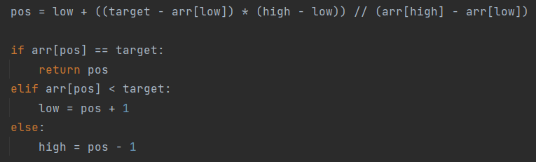
pos$=low +\frac{\left(target − arr[low]\right) ∗ (high −low)}{(arr\left[high\right] − arr[low])}$
$$low=0$$
high$=len\left(arr\right)−1$

Slide 12
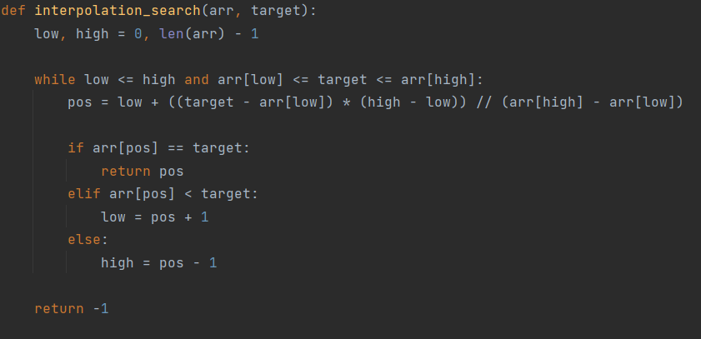
pos$=low +\frac{\left(target − arr[low]\right) ∗ (high −low)}{(arr\left[high\right] − arr[low])}$
$$low=0$$
high$=len\left(arr\right)−1$

Slide 13
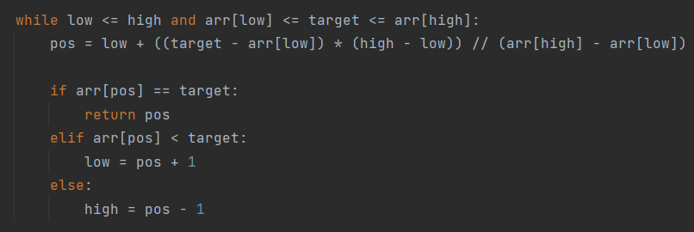

Implementation
0
1
2
3
4
5
6
7
8
9
10
11
12
13
14
15
16
17
18
19
1 | 3 | 7 | 10 | 14 | 15 | 16 | 18 | 20 | 21 | 22 | 23 | 25 | 33 | 35 | 42 | 45 | 47 | 50 | 52
L=0
H=19
pos$=L +\frac{\left(target − arr[L]\right) ∗ (H −L)}{(arr\left[H\right] − arr[L])}$
pos$=L +\frac{\left(target − arr[L]\right) ∗ (H −L)}{(arr\left[H\right] − arr[L])}$

Slide 14
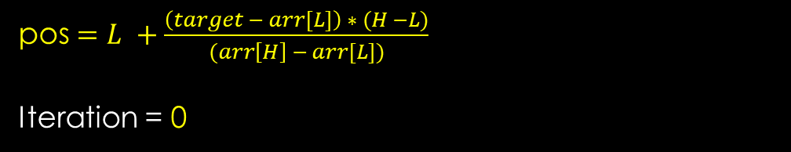
Target = 33
Implementation
0
1
2
3
4
5
6
7
8
9
10
11
12
13
14
15
16
17
18
19
1 | 3 | 7 | 10 | 14 | 15 | 16 | 18 | 20 | 21 | 22 | 23 | 25 | 33 | 35 | 42 | 45 | 47 | 50 | 52
L=0
H=19
pos$=L +\frac{\left(target − arr[L]\right) ∗ (H −L)}{(arr\left[H\right] − arr[L])}$
Iteration = 0
pos$=L +\frac{\left(target − arr[L]\right) ∗ (H −L)}{(arr\left[H\right] − arr[L])}$

Slide 15
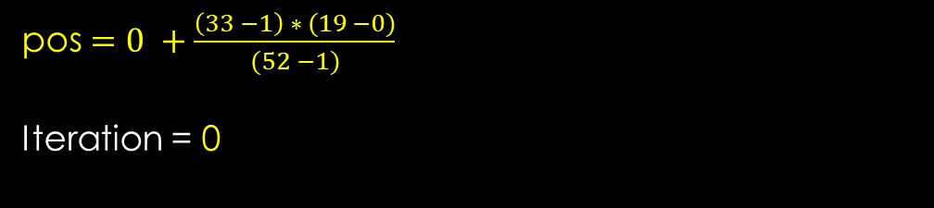
Target = 33
Implementation
0
1
2
3
4
5
6
7
8
9
10
11
12
13
14
15
16
17
18
19
1 | 3 | 7 | 10 | 14 | 15 | 16 | 18 | 20 | 21 | 22 | 23 | 25 | 33 | 35 | 42 | 45 | 47 | 50 | 52
L=0
H=19
pos$=0 +\frac{\left(33 −1\right) ∗ (19 −0)}{(52 −1)}$
Iteration = 0
pos$=L +\frac{\left(target − arr[L]\right) ∗ (H −L)}{(arr\left[H\right] − arr[L])}$

Slide 16

Target = 33
Implementation
pos
0
1
2
3
4
5
6
7
8
9
10
11
12
13
14
15
16
17
18
19
1 | 3 | 7 | 10 | 14 | 15 | 16 | 18 | 20 | 21 | 22 | 23 | 25 | 33 | 35 | 42 | 45 | 47 | 50 | 52
L=0
H=19
pos$=0 +\frac{\left(33 −1\right) ∗ (19 −0)}{(52 −1)}$ = 11
Iteration = 0
pos$=L +\frac{\left(target − arr[L]\right) ∗ (H −L)}{(arr\left[H\right] − arr[L])}$

Slide 17
Target = 33
Implementation
pos
0
1
2
3
4
5
6
7
8
9
10
11
12
13
14
15
16
17
18
19
1 | 3 | 7 | 10 | 14 | 15 | 16 | 18 | 20 | 21 | 22 | 23 | 25 | 33 | 35 | 42 | 45 | 47 | 50 | 52
L=0
H=19
pos$=0 +\frac{\left(33 −1\right) ∗ (19 −0)}{(52 −1)}$ = 11
Iteration = 0
pos$=L +\frac{\left(target − arr[L]\right) ∗ (H −L)}{(arr\left[H\right] − arr[L])}$

Slide 18

Target = 33
Implementation
pos
0
1
2
3
4
5
6
7
8
9
10
11
12
13
14
15
16
17
18
19
1 | 3 | 7 | 10 | 14 | 15 | 16 | 18 | 20 | 21 | 22 | 23 | 25 | 33 | 35 | 42 | 45 | 47 | 50 | 52
L=12
H=19
pos$=0 +\frac{\left(33 −1\right) ∗ (19 −0)}{(52 −1)}$ = 11
Iteration = 1
pos$=L +\frac{\left(target − arr[L]\right) ∗ (H −L)}{(arr\left[H\right] − arr[L])}$

Slide 19
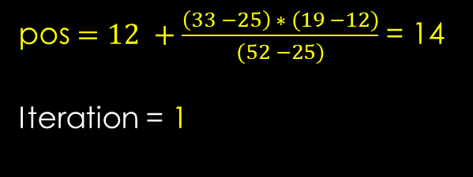
Target = 33
Implementation
pos
0
1
2
3
4
5
6
7
8
9
10
11
12
13
14
15
16
17
18
19
1 | 3 | 7 | 10 | 14 | 15 | 16 | 18 | 20 | 21 | 22 | 23 | 25 | 33 | 35 | 42 | 45 | 47 | 50 | 52
L=12
H=19
pos$=12 +\frac{\left(33 −25\right) ∗ (19 −12)}{(52 −25)}$ = 14
Iteration = 1
pos$=L +\frac{\left(target − arr[L]\right) ∗ (H −L)}{(arr\left[H\right] − arr[L])}$

Slide 20
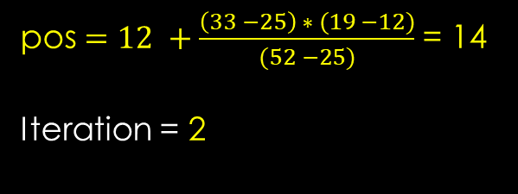
Target = 33
Implementation
pos
0
1
2
3
4
5
6
7
8
9
10
11
12
13
14
15
16
17
18
19
1 | 3 | 7 | 10 | 14 | 15 | 16 | 18 | 20 | 21 | 22 | 23 | 25 | 33 | 35 | 42 | 45 | 47 | 50 | 52
L=12
H=19
pos$=12 +\frac{\left(33 −25\right) ∗ (19 −12)}{(52 −25)}$ = 14
Iteration = 2
pos$=L +\frac{\left(target − arr[L]\right) ∗ (H −L)}{(arr\left[H\right] − arr[L])}$

Slide 21
Target = 33
Implementation
pos
0
1
2
3
4
5
6
7
8
9
10
11
12
13
14
15
16
17
18
19
1 | 3 | 7 | 10 | 14 | 15 | 16 | 18 | 20 | 21 | 22 | 23 | 25 | 33 | 35 | 42 | 45 | 47 | 50 | 52
L=12
H=19
pos$=12 +\frac{\left(33 −25\right) ∗ (19 −12)}{(52 −25)}$ = 14
Iteration = 2
pos$=L +\frac{\left(target − arr[L]\right) ∗ (H −L)}{(arr\left[H\right] − arr[L])}$

Slide 22

Target = 33
Implementation
pos
0
1
2
3
4
5
6
7
8
9
10
11
12
13
14
15
16
17
18
19
1 | 3 | 7 | 10 | 14 | 15 | 16 | 18 | 20 | 21 | 22 | 23 | 25 | 33 | 35 | 42 | 45 | 47 | 50 | 52
L=12
H=13
pos$=12 +\frac{\left(33 −25\right) ∗ (13 −12)}{(33 −25)}$ = 13
Iteration = 2
pos$=L +\frac{\left(target − arr[L]\right) ∗ (H −L)}{(arr\left[H\right] − arr[L])}$

Slide 23

Target = 33
Implementation
pos
0
1
2
3
4
5
6
7
8
9
10
11
12
13
14
15
16
17
18
19
1 | 3 | 7 | 10 | 14 | 15 | 16 | 18 | 20 | 21 | 22 | 23 | 25 | 33 | 35 | 42 | 45 | 47 | 50 | 52
L=12
H=13
pos$=12 +\frac{\left(33 −25\right) ∗ (13 −12)}{(33 −25)}$ = 13
Iteration = 3
pos$=L +\frac{\left(target − arr[L]\right) ∗ (H −L)}{(arr\left[H\right] − arr[L])}$

Slide 24
Analysis

Slide 25

Analysis
$$T\left(n\right)=1+T\left(\frac{n}{c}\right)$$

Slide 26
Analysis
$$T\left(n\right)=1+T\left(\frac{n}{c}\right)$$
Assuming n is a power of c, we can express n as $c^{k}$where k = $\log_{c} n$

Slide 27

Analysis
$$T\left(n\right)=1+T\left(\frac{n}{c}\right)$$
Assuming n is a power of c, we can express n as $c^{k}$where k = $\log_{c} n$
$T$($c^{k}$)$=1+T\left(\frac{n}{c}\right)$

Slide 28

Analysis
$$T\left(n\right)=1+T\left(\frac{n}{c}\right)$$
Assuming n is a power of c, we can express n as $c^{k}$where k = $\log_{c} n$
$T$($c^{k}$)$=1+T\left(\frac{n}{c}\right)$ = $T$($c^{k}$)$=1+T\left(c^{k −1}\right)$

Slide 29
Analysis
$$T\left(n\right)=1+T\left(\frac{n}{c}\right)$$
Assuming n is a power of c, we can express n as $c^{k}$where k = $\log_{c} n$
$T$($c^{k}$)$=1+T\left(\frac{n}{c}\right)$ = $T$($c^{k}$)$=1+T\left(c^{k −1}\right)$
$T$($c^{k}$)$=$ 1 + 1 + 1 + 1………. + 1 + $T\left(1\right)$

Slide 30
Analysis
$$T\left(n\right)=1+T\left(\frac{n}{c}\right)$$
Assuming n is a power of c, we can express n as $c^{k}$where k = $\log_{c} n$
$T$($c^{k}$)$=1+T\left(\frac{n}{c}\right)$ = $T$($c^{k}$)$=1+T\left(c^{k −1}\right)$
$T$($c^{k}$)$=$ 1 + 1 + 1 + 1………. + 1 + $T\left(1\right)$
$T$($c^{k}$)$=$ k + $T\left(1\right)$

Slide 31
Analysis
$$T\left(n\right)=1+T\left(\frac{n}{c}\right)$$
Assuming n is a power of c, we can express n as $c^{k}$where k = $\log_{c} n$
$T$($c^{k}$)$=1+T\left(\frac{n}{c}\right)$ = $T$($c^{k}$)$=1+T\left(c^{k −1}\right)$
$T$($c^{k}$)$=$ 1 + 1 + 1 + 1………. + 1 + $T\left(1\right)$
$T$($c^{k}$)$=$ k + $T\left(1\right)$
Now, substitute back k = $\log_{c} n$

Slide 32
Analysis
$$T\left(n\right)=1+T\left(\frac{n}{c}\right)$$
Assuming n is a power of c, we can express n as $c^{k}$where k = $\log_{c} n$
$T$($c^{k}$)$=1+T\left(\frac{n}{c}\right)$ = $T$($c^{k}$)$=1+T\left(c^{k −1}\right)$
$T$($c^{k}$)$=$ 1 + 1 + 1 + 1………. + 1 + $T\left(1\right)$
$T$($c^{k}$)$=$ k + $T\left(1\right)$
Now, substitute back k = $\log_{c} n$
$$T\left(n\right)=\log_{c} n+T\left(1\right)$$

Slide 33
Analysis
$$T\left(n\right)=1+T\left(\frac{n}{c}\right)$$
Assuming n is a power of c, we can express n as $c^{k}$where k = $\log_{c} n$
$T$($c^{k}$)$=1+T\left(\frac{n}{c}\right)$ = $T$($c^{k}$)$=1+T\left(c^{k −1}\right)$
$T$($c^{k}$)$=$ 1 + 1 + 1 + 1………. + 1 + $T\left(1\right)$
$T$($c^{k}$)$=$ k + $T\left(1\right)$
Now, substitute back k = $\log_{c} n$
$$T\left(n\right)=\log_{c} n+T\left(1\right)$$
$$T\left(n\right)=\log_{c} n$$

Slide 34

Analysis
$$T\left(n\right)=1+T\left(\frac{n}{c}\right)$$
Assuming n is a power of c, we can express n as $c^{k}$where k = $\log_{c} n$
$T$($c^{k}$)$=1+T\left(\frac{n}{c}\right)$ = $T$($c^{k}$)$=1+T\left(c^{k −1}\right)$
$T$($c^{k}$)$=$ 1 + 1 + 1 + 1………. + 1 + $T\left(1\right)$
$T$($c^{k}$)$=$ k + $T\left(1\right)$
Now, substitute back k = $\log_{c} n$
$$T\left(n\right)=\log_{c} n+T\left(1\right)$$
$$T\left(n\right)=\log_{c} n$$
$$\log_{c} n$$

Slide 35

Analysis
$$T\left(n\right)=1+T\left(\frac{n}{c}\right)$$
Assuming n is a power of c, we can express n as $c^{k}$where k = $\log_{c} n$
$T$($c^{k}$)$=1+T\left(\frac{n}{c}\right)$ = $T$($c^{k}$)$=1+T\left(c^{k −1}\right)$
$T$($c^{k}$)$=$ 1 + 1 + 1 + 1………. + 1 + $T\left(1\right)$
$T$($c^{k}$)$=$ k + $T\left(1\right)$
Now, substitute back k = $\log_{c} n$
$$T\left(n\right)=\log_{c} n+T\left(1\right)$$
$$T\left(n\right)=\log_{c} n$$
$\log_{c} n$ = $\frac{\log{n}}{\log{c}}$

Slide 36

Analysis
$$T\left(n\right)=1+T\left(\frac{n}{c}\right)$$
Assuming n is a power of c, we can express n as $c^{k}$where k = $\log_{c} n$
$T$($c^{k}$)$=1+T\left(\frac{n}{c}\right)$ = $T$($c^{k}$)$=1+T\left(c^{k −1}\right)$
$T$($c^{k}$)$=$ 1 + 1 + 1 + 1………. + 1 + $T\left(1\right)$
$T$($c^{k}$)$=$ k + $T\left(1\right)$
Now, substitute back k = $\log_{c} n$
$$T\left(n\right)=\log_{c} n+T\left(1\right)$$
$$T\left(n\right)=\log_{c} n$$
$\log_{c} n$ = $\frac{\log{n}}{\log{c}}=\log{\log{n}}$

Slide 37
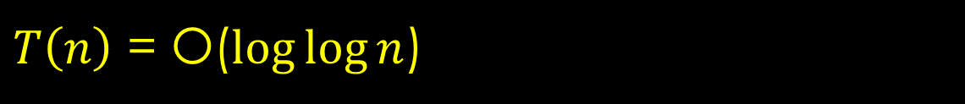
Analysis
$$T\left(n\right)=1+T\left(\frac{n}{c}\right)$$
Assuming n is a power of c, we can express n as $c^{k}$where k = $\log_{c} n$
$T$($c^{k}$)$=1+T\left(\frac{n}{c}\right)$ = $T$($c^{k}$)$=1+T\left(c^{k −1}\right)$
$T$($c^{k}$)$=$ 1 + 1 + 1 + 1………. + 1 + $T\left(1\right)$
$T$($c^{k}$)$=$ k + $T\left(1\right)$
Now, substitute back k = $\log_{c} n$
$$T\left(n\right)=\log_{c} n+T\left(1\right)$$
$T\left(n\right)$ = O($\log{\log{n}}$)
$$T\left(n\right)=\log_{c} n$$
$\log_{c} n$ = $\frac{\log{n}}{\log{c}}=\log{\log{n}}$

Slide 38
Interpolation Search Vs Binary Search

Slide 39
Interpolation Search Vs Binary Search
Interpolation Search
Binary Search

Slide 40

Interpolation Search Vs Binary Search
Interpolation Search
Binary Search
Best Case: O$(1)$
Best Case: O$(1)$

Slide 41

Interpolation Search Vs Binary Search
Interpolation Search
Binary Search
Best Case: O$(1)$
Best Case: O$(1)$
Average Case: $O(\log{\log{n)}}$
Average Case: $O(\log{n)}$

Slide 42

Interpolation Search Vs Binary Search
Interpolation Search
Binary Search
Best Case: O$(1)$
Best Case: O$(1)$
Average Case: $O(\log{\log{n)}}$
Average Case: $O(\log{n)}$
Worst Case: $O(n)$
Worst Case: $O(\log{n})$

Slide 43
Interpolation Search Vs Binary Search
Interpolation Search
Binary Search
Best Case: O$(1)$
Best Case: O$(1)$
Average Case: $O(\log{\log{n)}}$
Average Case: $O(\log{n)}$
Worst Case: $O(n)$
Worst Case: $O(\log{n})$

Slide 44
Thank
You

